Slide 1
01
Welcome
to
Emergency Medical Center

Slide 2
Project Made By :
02
Tayyab Naseem.
Aliza Ghulam Hussain .
Muznah Rehman.
Mentor : Sir Hammad

Slide 3
Introduction :
03
Our website represent the coronavirus . Where patients easily book appointments and take vaccination from nearby hospitals . And this website allow hospitals to summarize the reports to generate the reports and approved vaccination of the user .
We have admin panel on this website which fetch the patients details and generate the reports as per the daily status of vaccination and approved the patients status.

Slide 4
Admin :
04
Functional Requirements / Specification
Admin can view all patients details .
Admin can view the availability of vaccination .
Admin can view the hospital details.
Admin can view the booking details from patient side for booking corona test results.
Admin can approve hospitals login.

Slide 5
Hospitals :
05
Hospitals will update the patient’s results.
Hospital can approve or reject the patients appointment.
Hospital can only see those patients who book their appointments on a particular hospitals.
Hospitals will update the patient’s vaccination status.

Slide 6
Patients:
06
Patients can book their appointments.
Patients can apply for vaccination and Covid test.
Patients can see their results of Covid test and taken vaccination, they can also see their vaccination suggestions provided by hospitals .
Patients can see the list of all hospitals and also each hospitals address and timing .
Patients can also cancel their panding appointments.

Slide 7
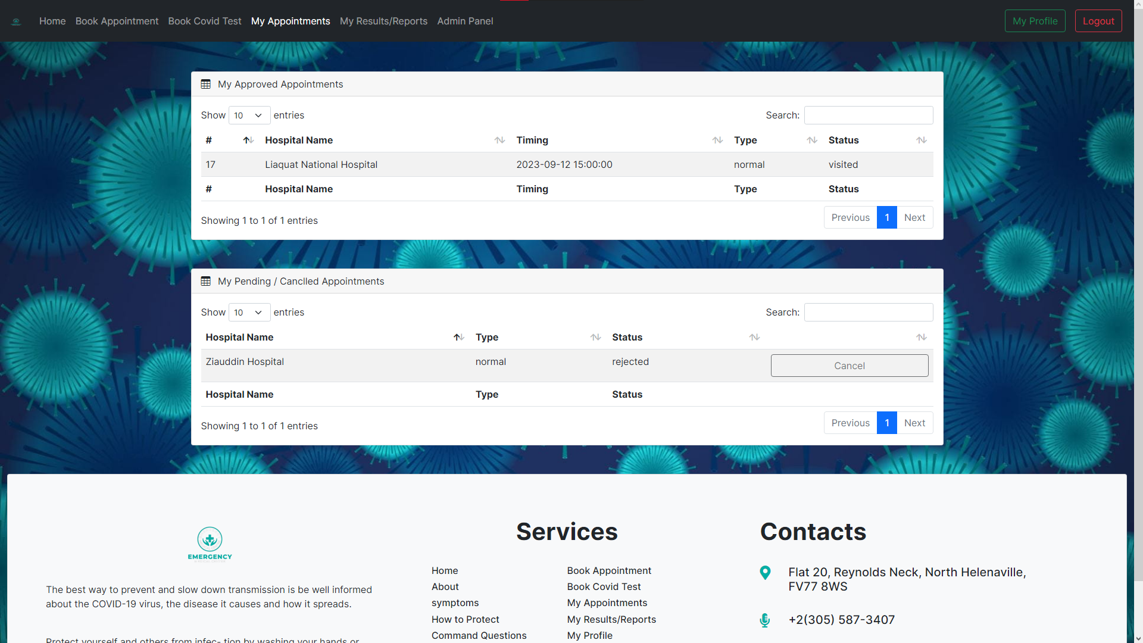

Slide 8
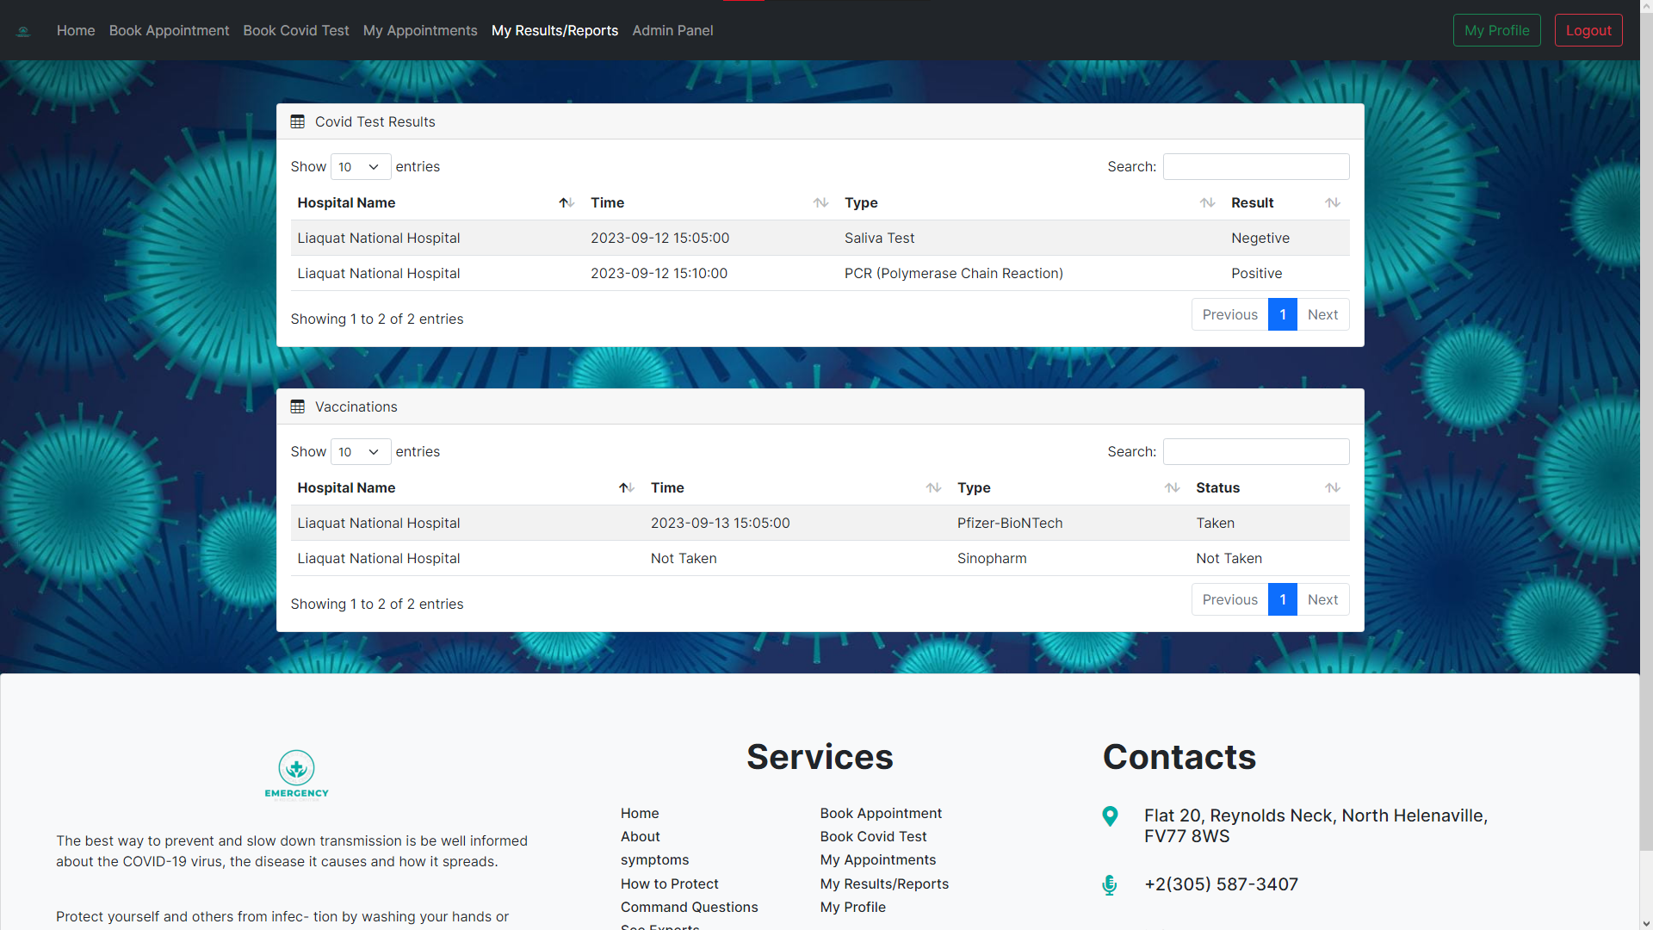

Slide 9
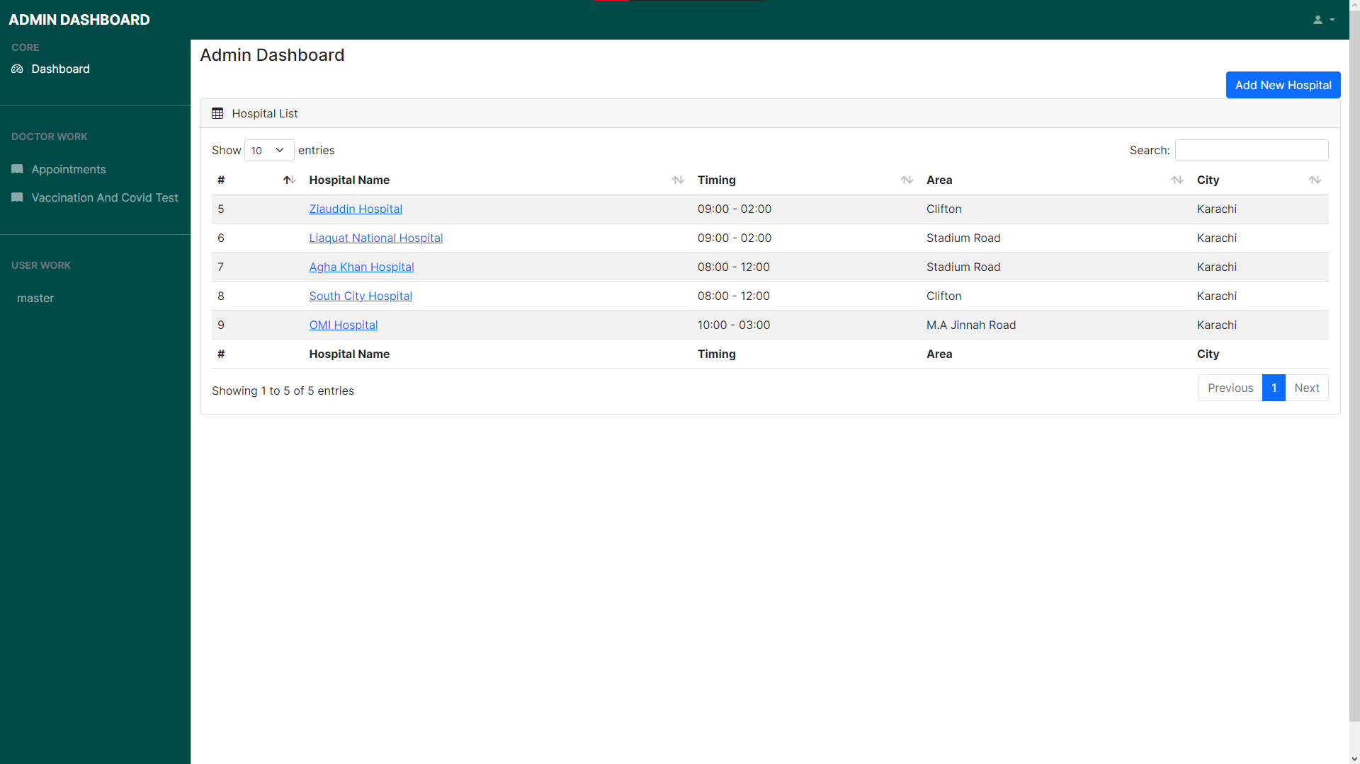

Slide 10
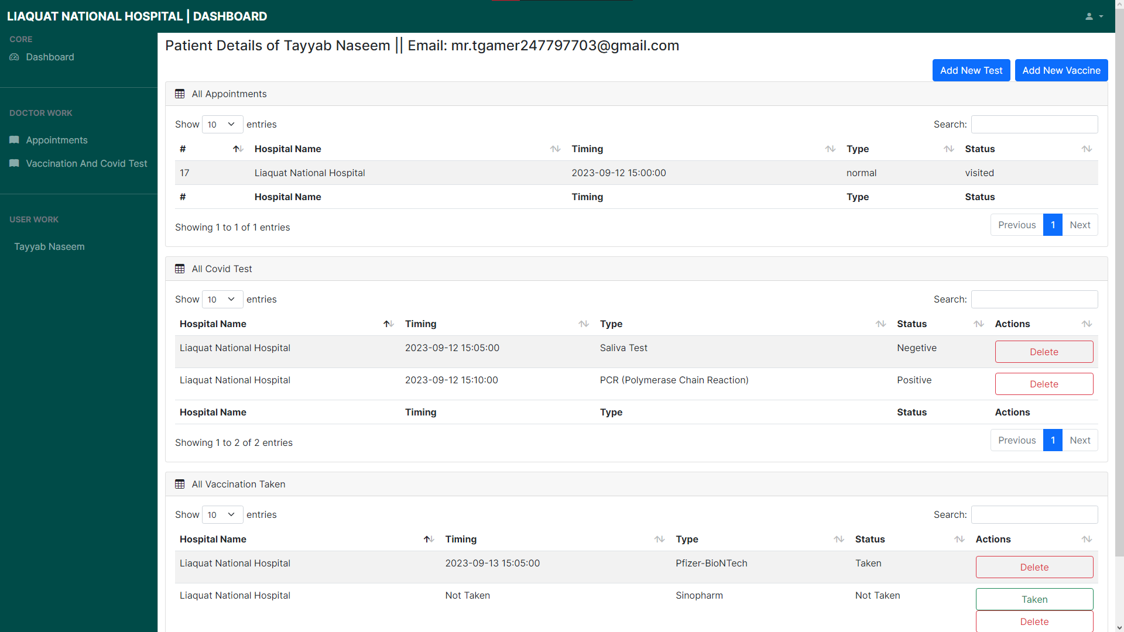

Slide 11
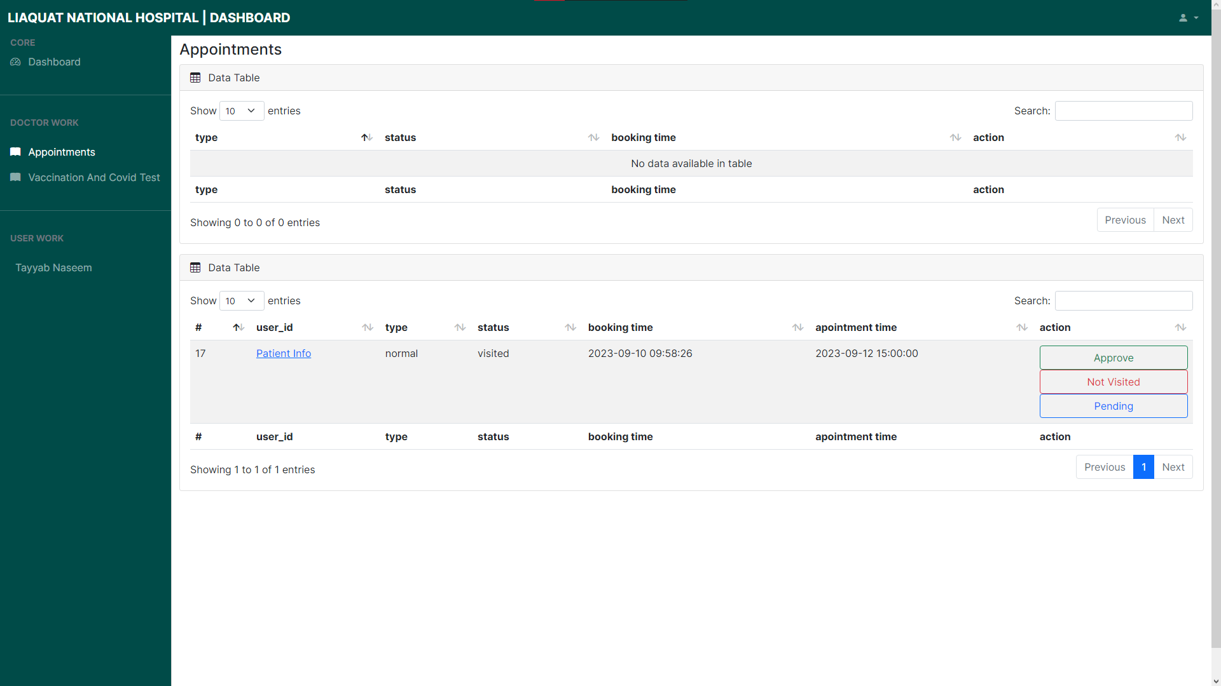

Slide 12
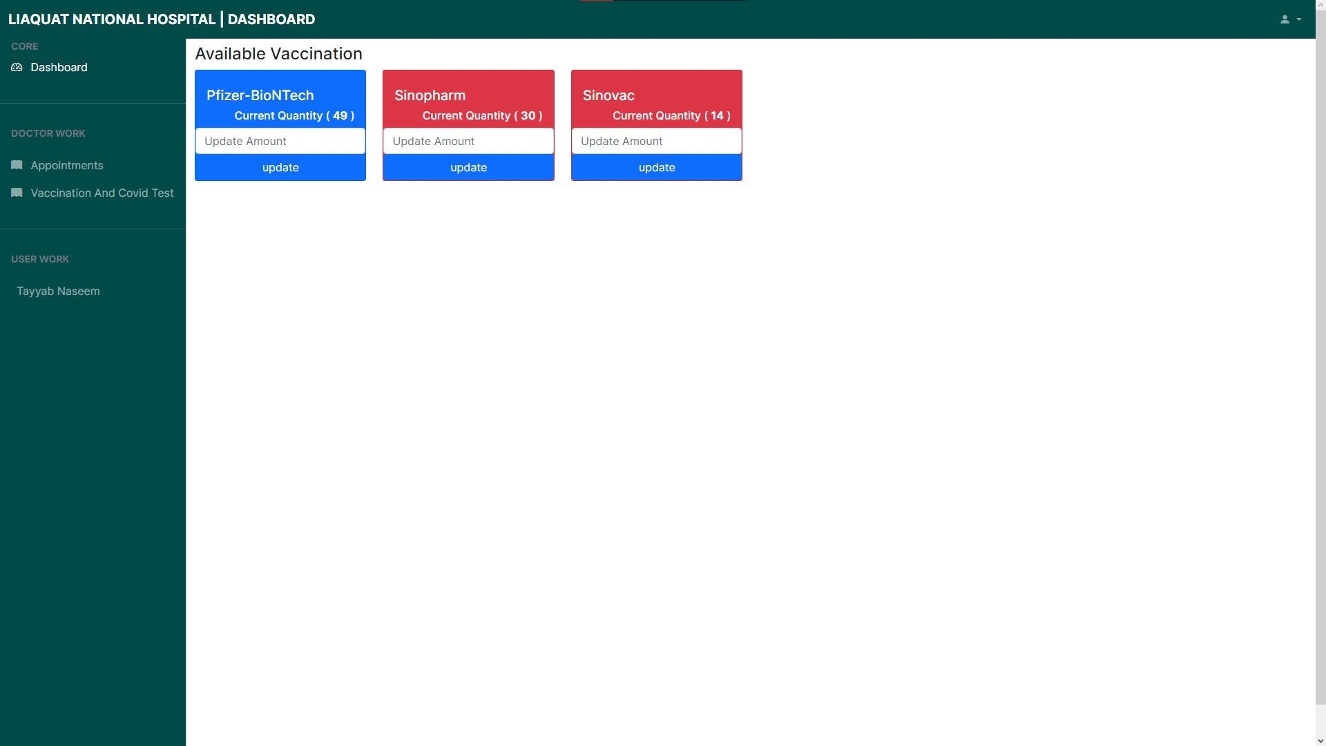

Slide 13
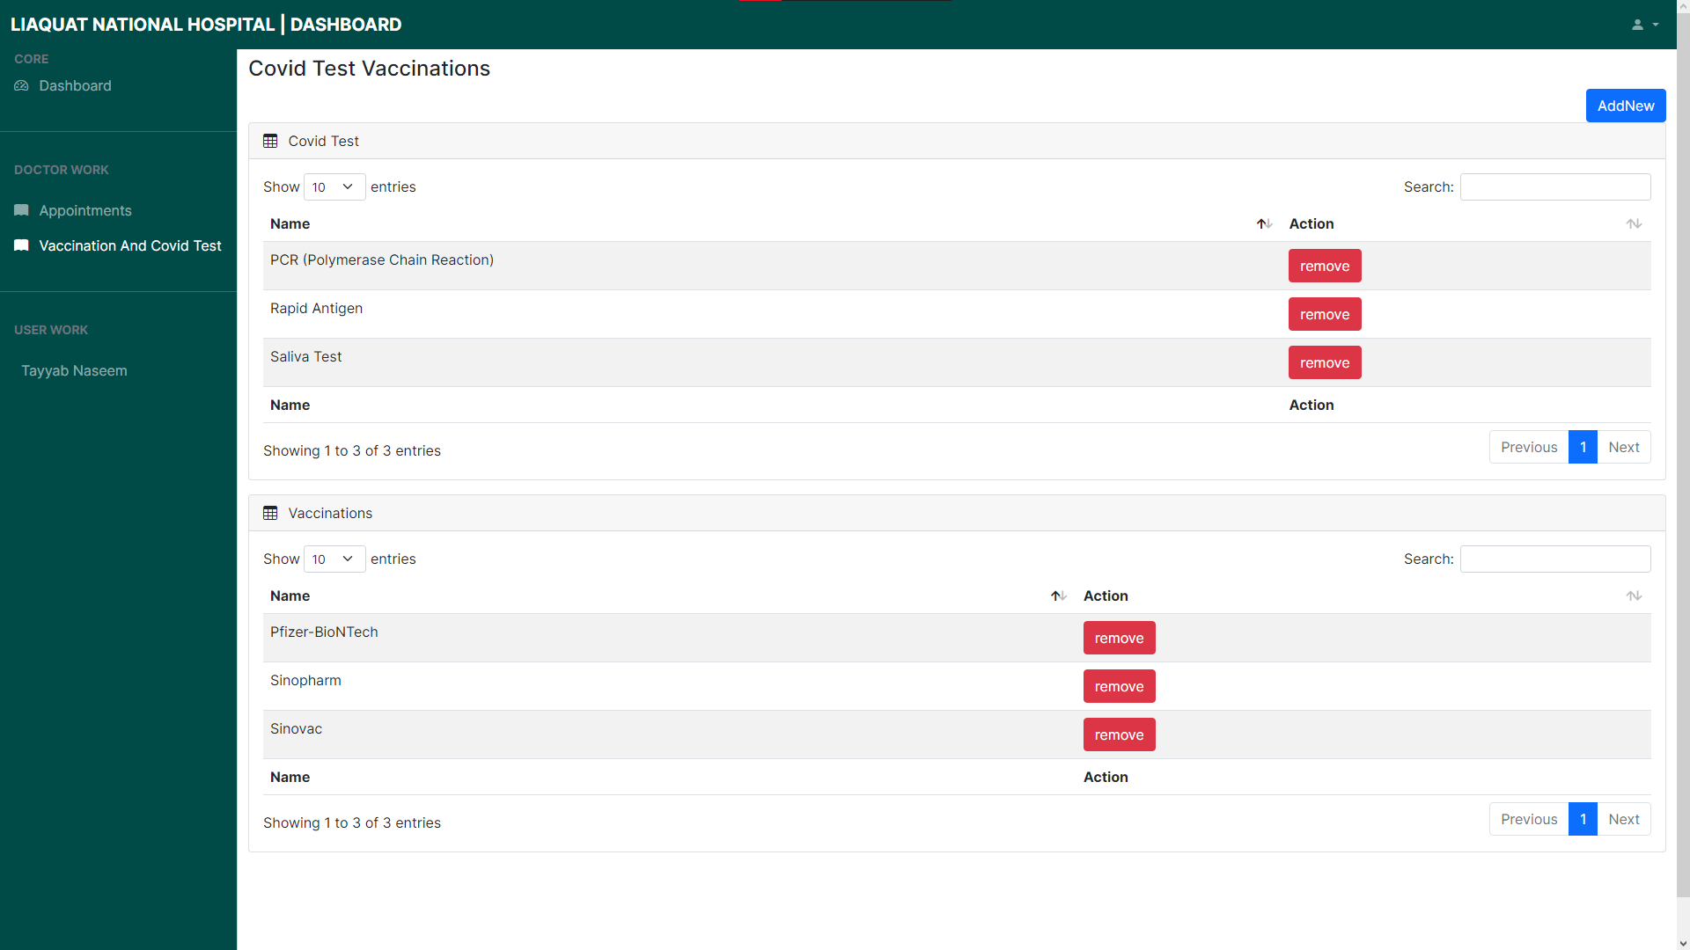

Slide 14
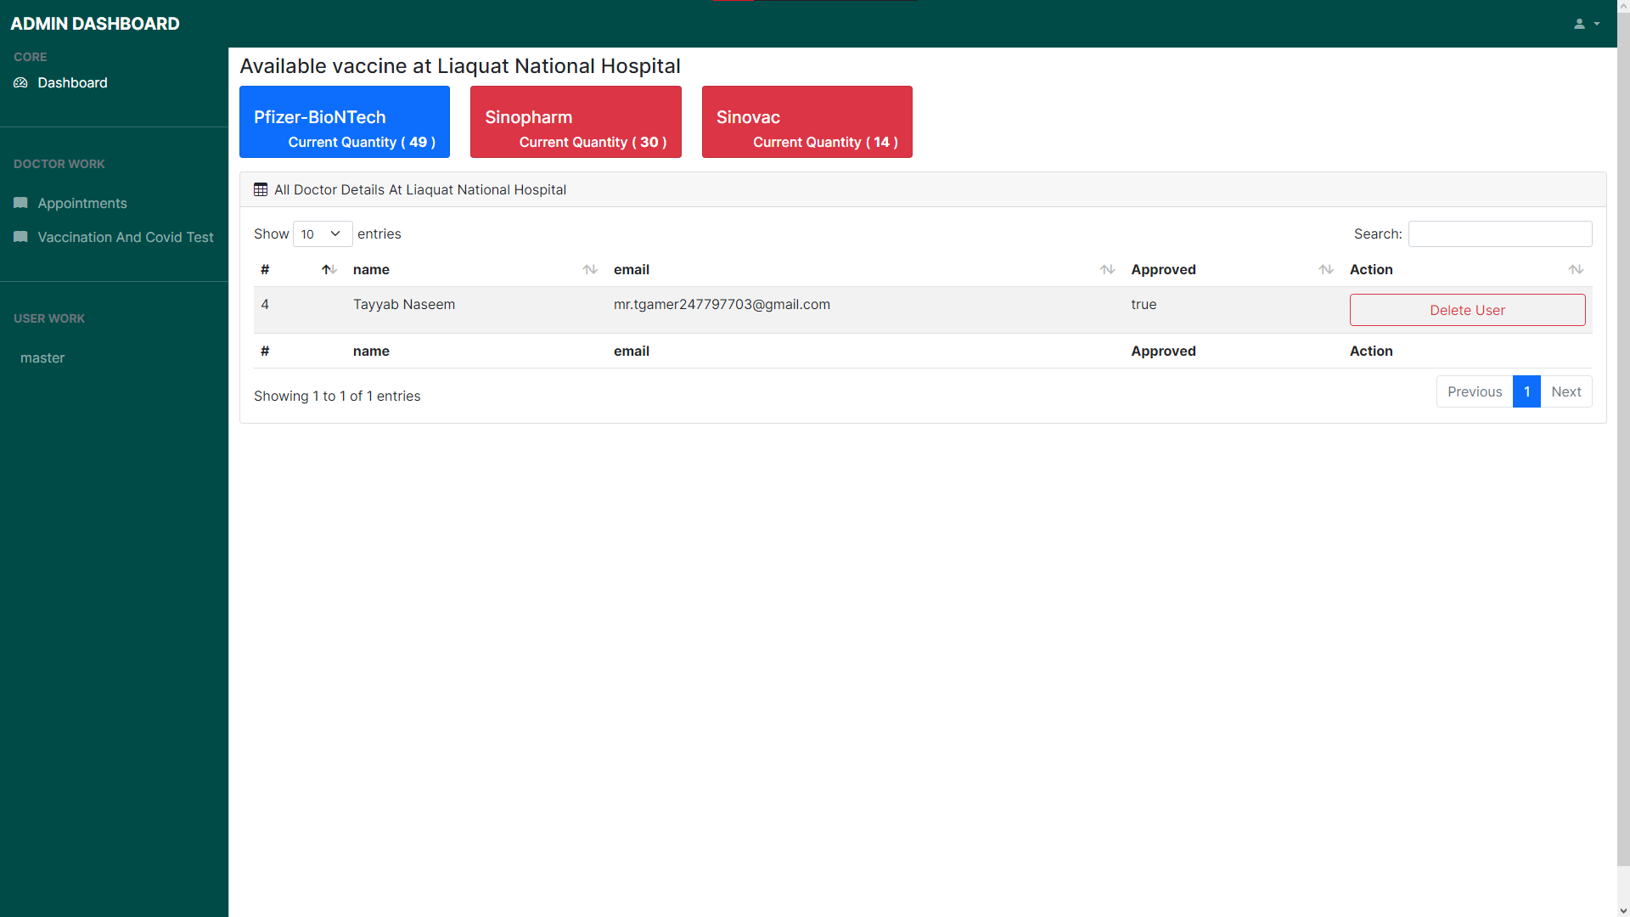

Slide 15
Thankyou….
15

